Slide 1
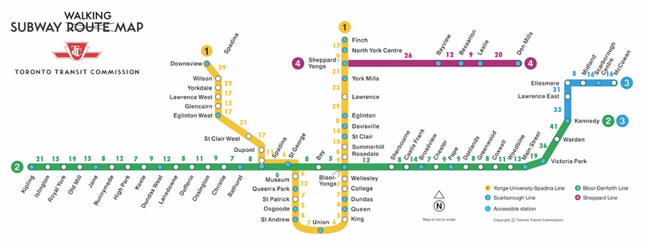
TTC Subway Delay Analysis

Slide 2
Agenda
Overall Delay
Delay by Weekday
Delay by Issue Type
Delay by Line
Delay by Station
Delay by hour of the day
Conclusion

Slide 3
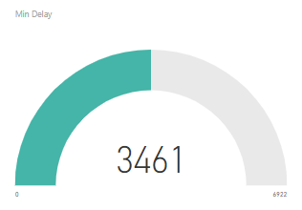
Overall Delay
The Toronto subway is a rapid transit system serving Toronto and the neighbouring city of Vaughan in Ontario, Canada, operated by the Toronto Transit Commission (TTC).
Canada’s first and busiest railway line.
During the month of April 2019, TTC Subway was delayed for a total of 3461 minutes.

Slide 4
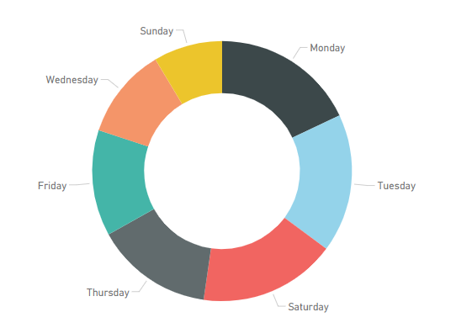
Delay by Weekday
It was observed that Monday, Tuesday and Saturday are the days where most number of delays occur.
Mondays experienced a total of 621 minutes of delay (17.94%)
Tuesday experienced a total of 597 minutes of delay (17.25%)
Saturday experienced a total of 591 minutes of delay (17.08%)
Sunday being the lowest, experienced a total of 296 minutes of delay (8.55%)

Slide 5
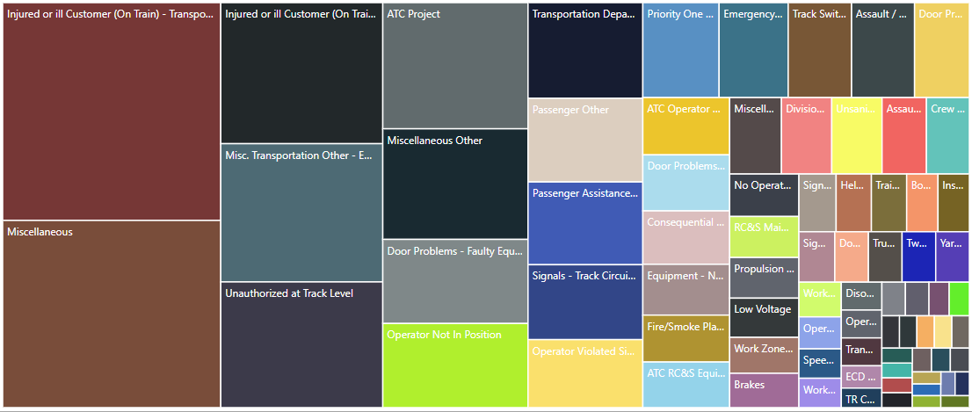
Delay by Issue Type
Most interesting insight about the causes of delay was observed to be passengers getting injured.

Slide 6
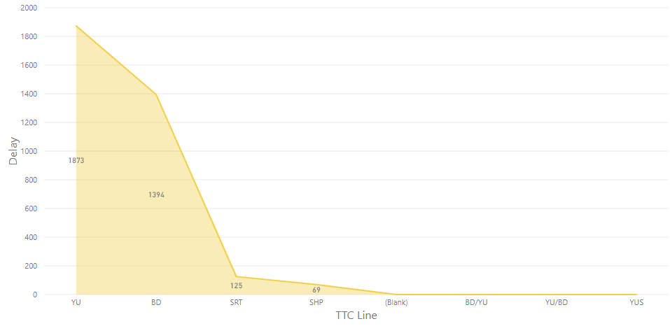
Delay by Line
Yonge-University line which has 38 stations and is 38.8 km (24.1 mi) in length, making it the longest line on the subway system is also the line that experienced longest duration of delay (1873 minutes)

Slide 7
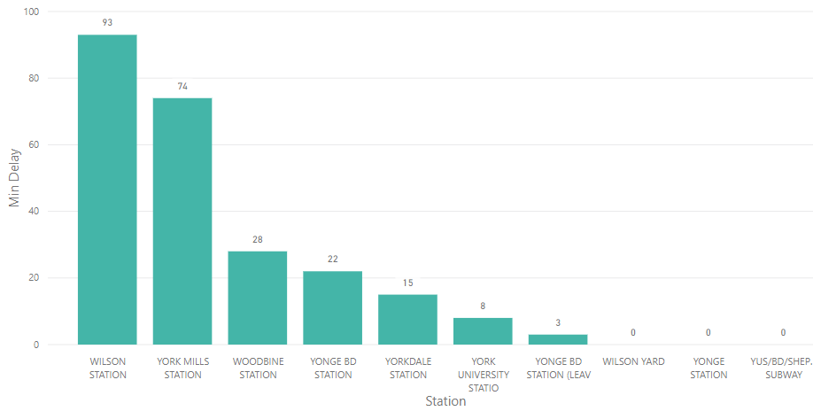
Delay by Station
Chart displays top 10 stations w.r.t minutes of delay.
Wilson Station accounts to 93 minutes of delay followed by York Mills Station.

Slide 8
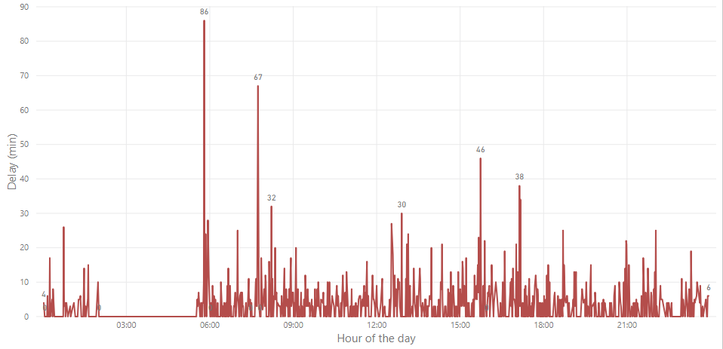
Delay by Hour of the Day
Early morning ~6:00 am appears to be the peak delay hour.
It is also the onset of peak rush hours since most offices start after this time.

Slide 9
Conclusion
After visualizing various causes of delay, we can now work on strategies for minimising the delay.
Measures such as increasing the security at certain stations will help in reducing passengers getting injured and thereby minimise delay time.
Increasing the availability of engineers during peak hours can help minimising the delay caused by certain defects in the trains.

